Slide 1
Computer Graphics Summer ‘19 Project
Bakir Bascelic
Saint Anselm College

Slide 2

Images done in Processing programming language
Processing website: https://processing.org

Slide 3

//file:week2/randcircles.pde//;
void setup(){
size(200,200);
background(randColor());//random
int d=int(random(50,width/2));
int yc=int(random(50,height));
int xc=int(random(50,width));
fill(randColor());
ellipse(xc,yc,d,d);
d=int(random(50,width/2));
yc=int(random(50,height));
xc=int(random(50,width));
fill(randColor());
ellipse(xc,yc,d,d);
d=int(random(50,width/2));
yc=int(random(50,height));
xc=int(random(50,width));
fill(randColor());
ellipse(xc,yc,d,d);
}
//setup
color randColor(){
return color(random(255),random(255),random(255));
}

Slide 4

Mellow Mood

Slide 5

The flag’s design and color was influenced by my family’s roots dating back generations to Bosnia.
Homefront

Slide 6


Slide 7

Hypnotic

Slide 8
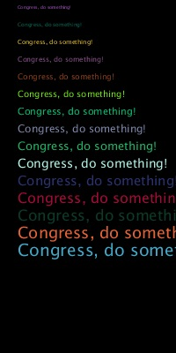
On August 4th, 2019 during a goal celebration, Philadelphia’s Alejandro Bedoya grabbed a microphone from the field and shouted
“Congress, do something!
End gun violence.”
This piece is a tribute to Bedoya’s bravery.
Us or Guns

Slide 9

//filename: enchanting.pde//
void setup(){
size(600,390);
background(255);
rectMode(CENTER);
int many=60;
int s=5;
noFill();
for (int i=0; i<many;i++){
strokeWeight(random(5));
stroke(0);
rect(width/2,height/2,i*s,i*s);
}//loop
}
Enchanting

Slide 10

The challenge for this piece was molding various elements of visual imagery into one functional image. The plane, the shape above the plane, as well as the text all work together to form a logo for this fictional airline.

Slide 11
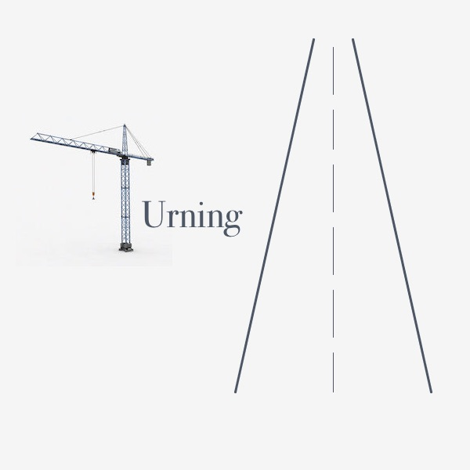
The image of the crane is combined with the shape of the road and the text to create the logo for a fictional construction company- Turning.

Slide 12

This Bosnian inspired flag plays with key elements of the culture like the soccer balls and the Fleur-de-lis that is associated with the Bosniak ethnicity.

Slide 13

This is my take on the Albers classic- Homage to the Square:
Apparition.
Homage to Albers

Slide 14


Collective Edges

Slide 15
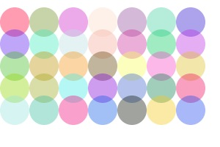
Fading Circle of Life

Slide 16

//filename:pollockcircles//
void setup(){
size(500,500);
background(255);
for (int i=0; i<100;i++){
int xc=int(random(width));
int yc=int(random(height));
int d=int(random(50));
int r= int(random(255));
int g= int(random(255));
int b=int(random(255));
color c= color(r,g,b,random(70,200));
stroke(c);//color is c
strokeWeight(random(20));
ellipse(xc,yc,d,d);
}
}

Slide 17

Colorful Abyss

Slide 18

Aquatic Wasteland

Slide 19
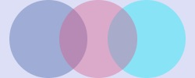
//file:Overlap.pde//;
void setup(){
size(250,100);
background(randColor());//random
noStroke();
fill(randColor(),100);
ellipse(62,50,100,100);
fill(randColor(),100);
ellipse(188,50,100,100);
fill(randColor(),100);
ellipse(126,50,100,100);
}
color randColor(){
return color(random(255),random(255),random(255));
}

Slide 20

Overlap

Slide 21
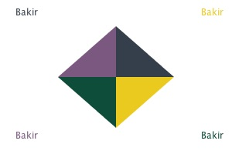
Converging Triangles

Slide 22
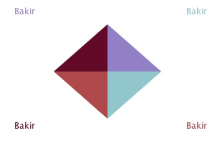

Slide 23

//file: H:chessnike.pde//
void setup(){
size(600,600);
PImage a1= loadImage("nike2.jpg");
PImage a2= loadImage("nikerev.tif");//150x150
int step=width/8;
for (int i=0; i<8; i++){
for (int j=0; j<8; j++){
if((i+j)% 2==0)//sum i+j is even then color is black
image(a1,i*step,j*step,a1.width/2,a1.height/2);
else
image(a2,i*step,j*step,a2.width/2,a2.height/2);
}}
}

Slide 24
The familiar Nike logo is visually attracting in the checkered design. The coding for this image was difficult as it involves multiple for loops and images that must be loaded separately. This piece taught me the importance of maintaining your digital workspace, organizing your files, and attention to detail. The behind the scenes work for this image is challenging but makes the final product worth the effort.

Slide 25
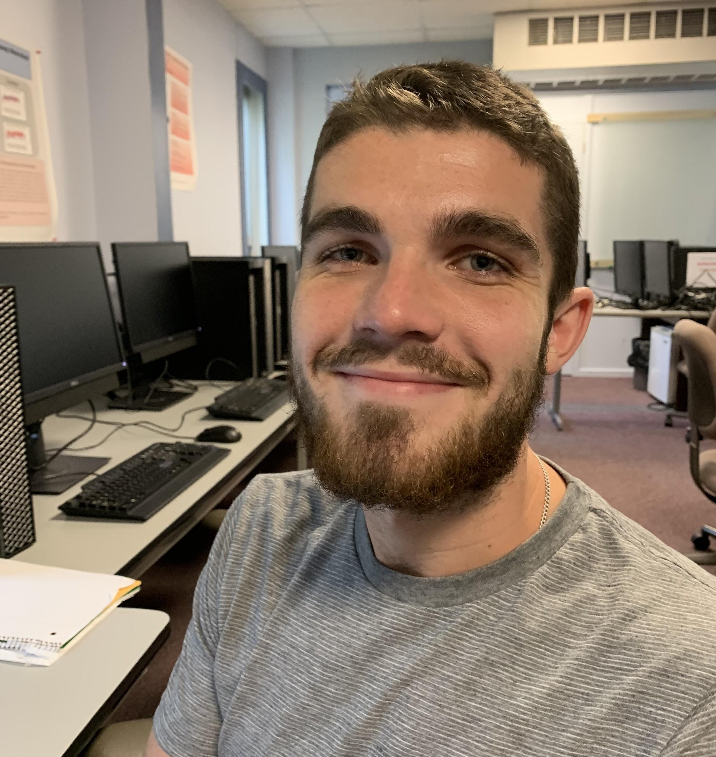
Design
Detail
Deliver
Bakir Bascelic

